Slide 1
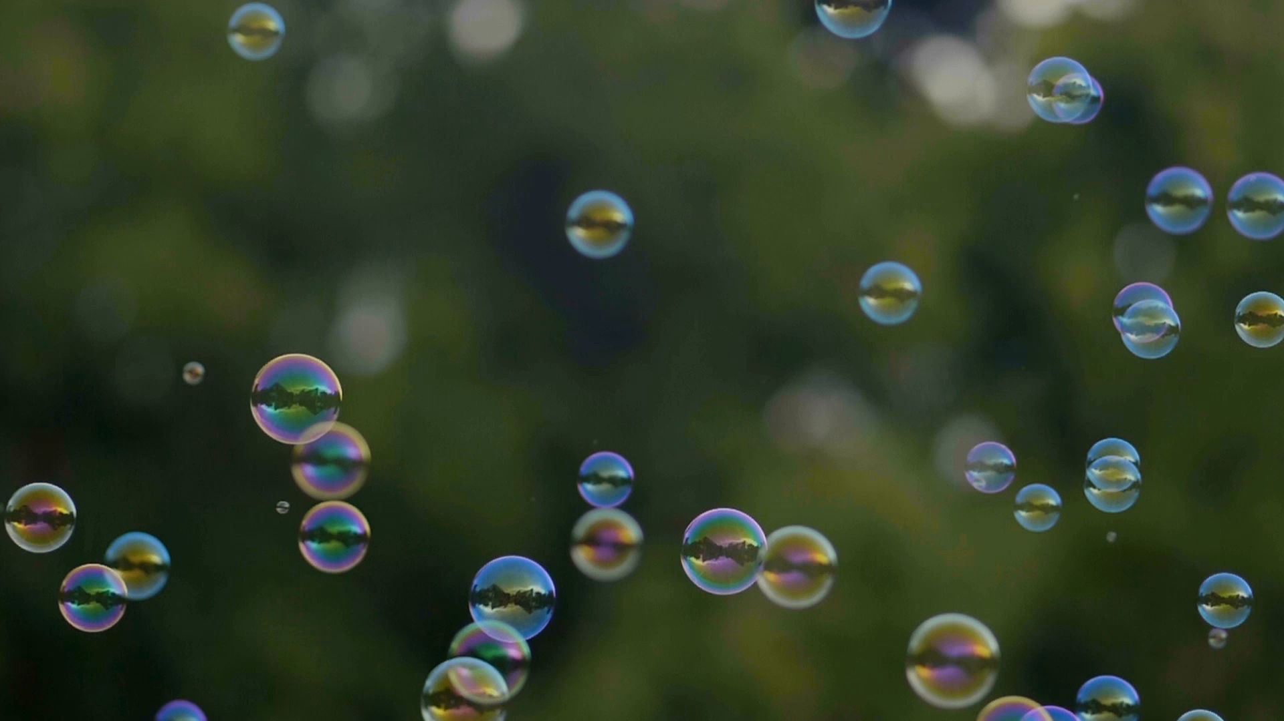
PRODUCTIONS
Powerpoint Tricks Vol 1

Slide 2
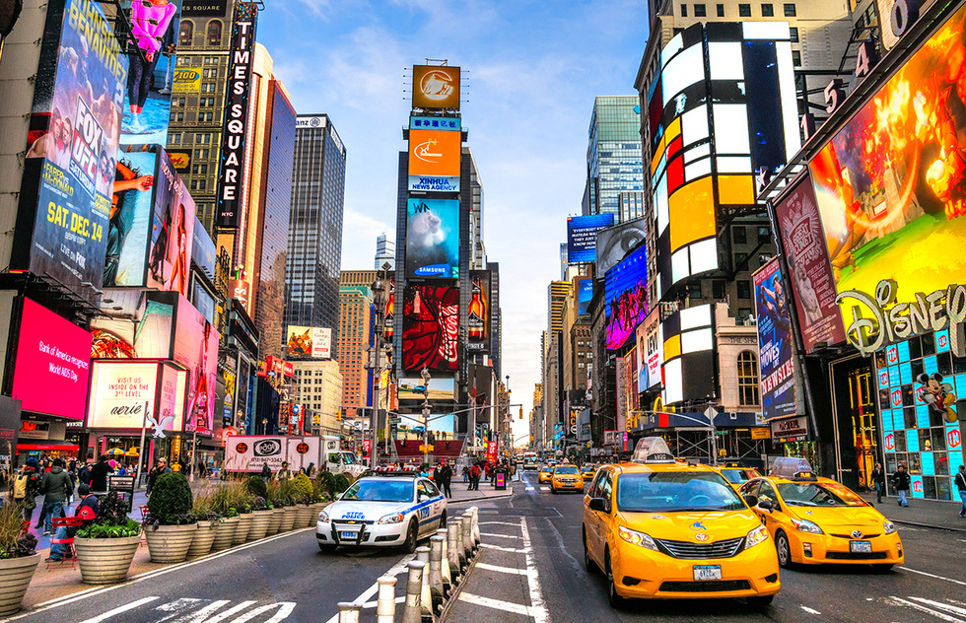

Slide 3
New York City
City of Light

Slide 4






2
3
1
6
5
4
TEACH
Changes and impact life.
MONEY
Make money while you sleep.
GROWN
Grow your business.
EDUCATION
School teaches you.
KNOWLEDGE
Knowledge is power.
FITNESS
Keep you in shape.

Slide 5
1
2
3
4
5
6
EDUCATION
School teaches you.
KNOWLEDGE
Knowledge is power.
FITNESS
Keep you in shape.
TEACH
Changes and impact life.
GROWN
Grow your business.
MONEY
Make money while you sleep.

Slide 6
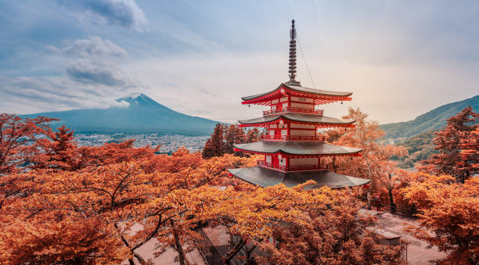
JAPAN
Japan is an archipelago, or string of islands, on the eastern edge of Asia. There are four main islands: Hokkaido, Honshu, Shikoku, and Kyushu.

Slide 7


Slide 8

2024
PRODUCT
ROADMAP
JAN | FEB | MAR | APR | MAY | JUN | JUL | AUG | SEP | OCT | NOV | DEC
LAUNCH
COMMISSION
UAT
Development
Requirements

